Slide 1
A Tool to Visualize the Evolution of Conference Topics
Gaole Meng¹, Zhuofeng Wu¹,
Yue Wang¹, Qiaozhu Mei¹
¹University of Michigan

Slide 2
Motivation: Topics shift exist
The research focus of conferences are always changing over time.
E.g., DL becomes a important part in NIPS, ICML etc.
Help us to model the research trend.

Slide 3
Challenge: Lack a standard to represent change of topics
Network embedding is a powerful tool:
convert a network into a low dimension space
keep some specific characteristics

Slide 4
Related Work: Embedding algorithms
LINE(Tang etc., 2015): nodes that share common nodes and are neighbors to each other in the network are located in close proximity to one another in the space
LargeVis(Tang etc., 2016): computes approximated kNN for each node with surprising efficient, layouts the graph in 2D or 3D space and preserves local structure at the same time.

Slide 5
Dataset: dblp_citation¹, overview
Summary:
3,079,007 papers and 25,166,994 citation relationships
Time: 1949-2017
Lack some data, e.g., SIGIR’15
Contains all papers(include full and short paper)
What we use:
Authors (only name, not affiliation)
References (index)
Venue (each conference has multiple aliases!)
Year
Id (an embeded index given by aminer)
¹https://static.aminer.cn/lab-datasets/citation/dblp.v10.zip

Slide 6
Dataset: dblp_citation¹, one record
Raw data:
{"authors": ["Dominik Szajerman", "Adam Jurczy\u0144ski"], "n_citation": 0, "references": ["3fcd7cdc-20e6-4ea3-a41c-db126fcc5cfe", "bf3a11ca-5c4b-4b26-9b7a-0881b8d0f6c2"], "title": "Fur Visualisation for Computer Game Engines and Real-Time Rendering", "venue": "international conference on computer vision and graphics", "year": 2014, "id": "00964544-cbe2-4da9-bb5a-03333160eb34"}
¹https://static.aminer.cn/lab-datasets/citation/dblp.v10.zip

Slide 7
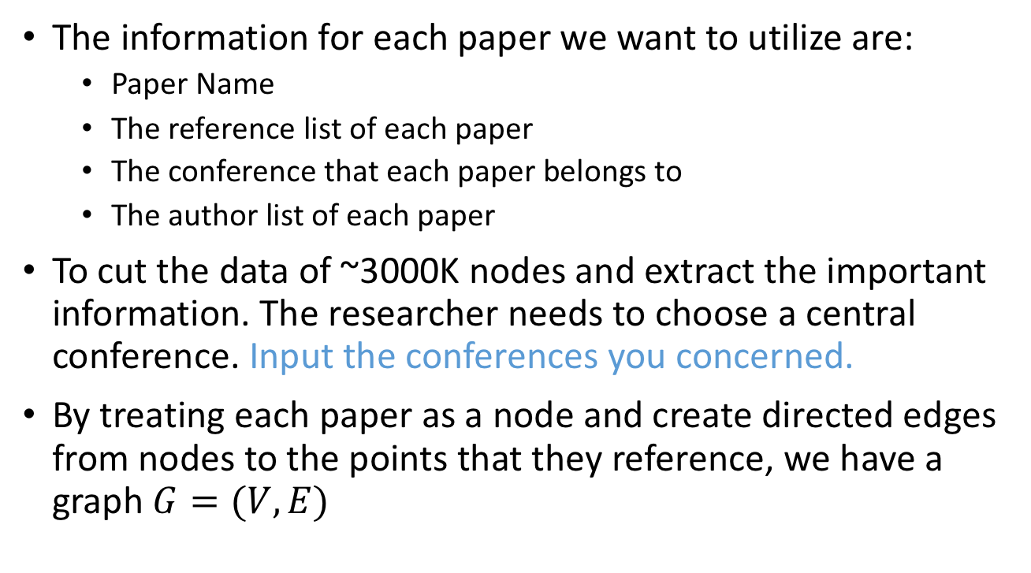
Step 1: Extract raw data and set central conference
The information for each paper we want to utilize are:
Paper Name
The reference list of each paper
The conference that each paper belongs to
The author list of each paper
To cut the data of ~3000K nodes and extract the important information. The researcher needs to choose a central conference. Input the conferences you concerned.
By treating each paper as a node and create directed edges from nodes to the points that they reference, we have a graph $G=(V, E)$

Slide 8
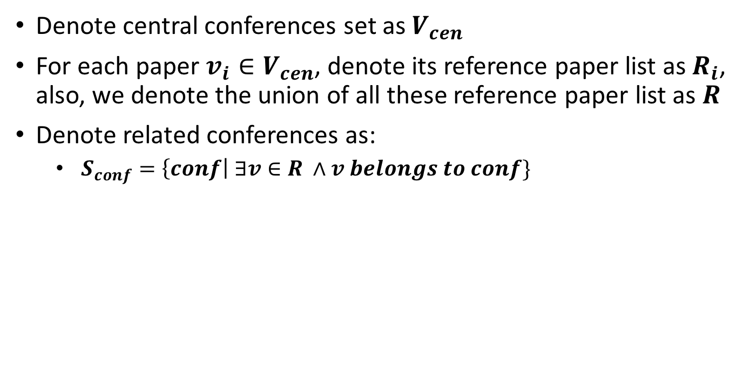
Step 2: Get related conferences
Denote central conferences set as $V_{cen}$
For each paper $v_{i}∈V_{cen}$, denote its reference paper list as $R_{i}$, also, we denote the union of all these reference paper list as $R$
Denote related conferences as:
$S_{conf}=\left\{conf\right| ∃v∈R ∧v belongs to conf\}$
Notes:
For each paper $V_{i}∈S_{cen}$, link a directed edge $e_{ij}$(with weight 1) to every paper $V_{j}$in $R_{i}$, ${∀v}_{i}∈S_{cen}, {∀v}_{j}∈R_{i}$

Slide 9
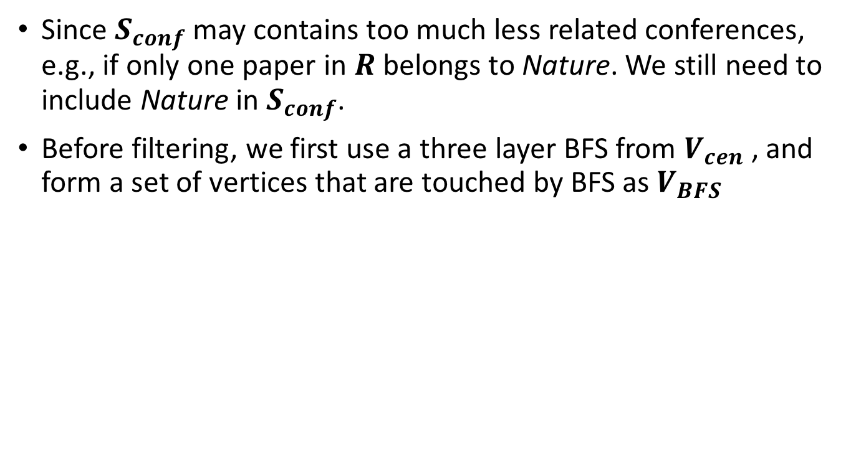
Step 3: Filter less-related conferences
Since $S_{conf}$ may contains too much less related conferences, e.g., if only one paper in $R$ belongs to Nature. We still need to include Nature in $S_{conf}$.
Before filtering, we first use a three layer BFS from $V_{cen}$, and form a set of vertices that are touched by BFS as $V_{BFS}$

Slide 10
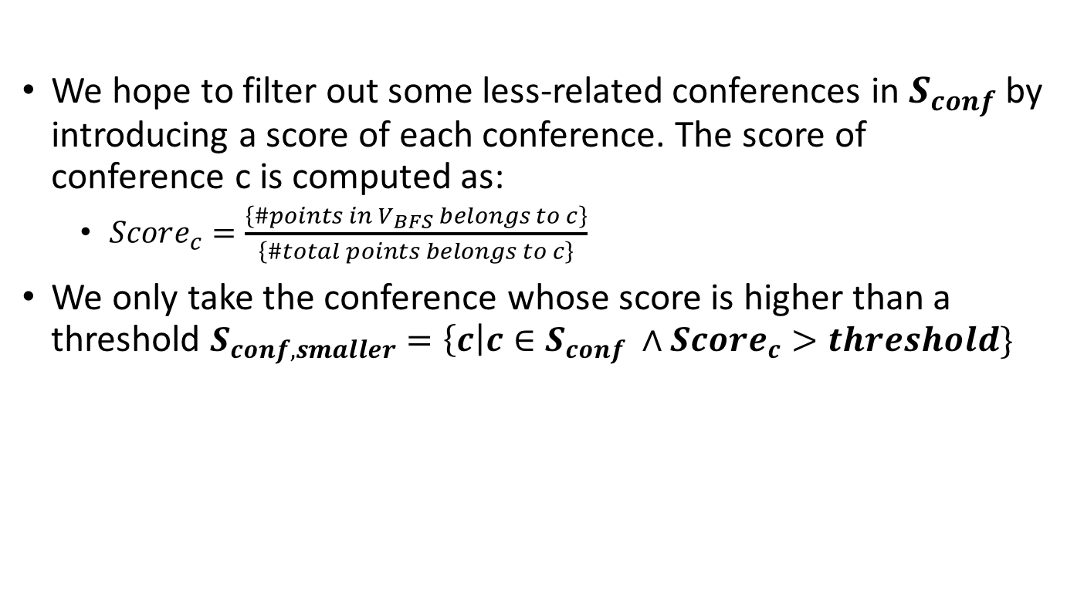
We hope to filter out some less-related conferences in $S_{conf}$by introducing a score of each conference. The score of conference c is computed as:
$Score_{c}=\frac{\left\{\#points in V_{BFS} belongs to c\right\}}{\left\{\#total points belongs to c\right\}}$
We only take the conference whose score is higher than a threshold $S_{conf, smaller}=\left\{c\right|c∈S_{conf} ∧{Score}_{c}>threshold\}$
Notes:
All paper: interests
Full paper: core of conferences
Don’t need the bfs algorithm anymore. Use a reference list(e.g., csrankings)

Slide 11
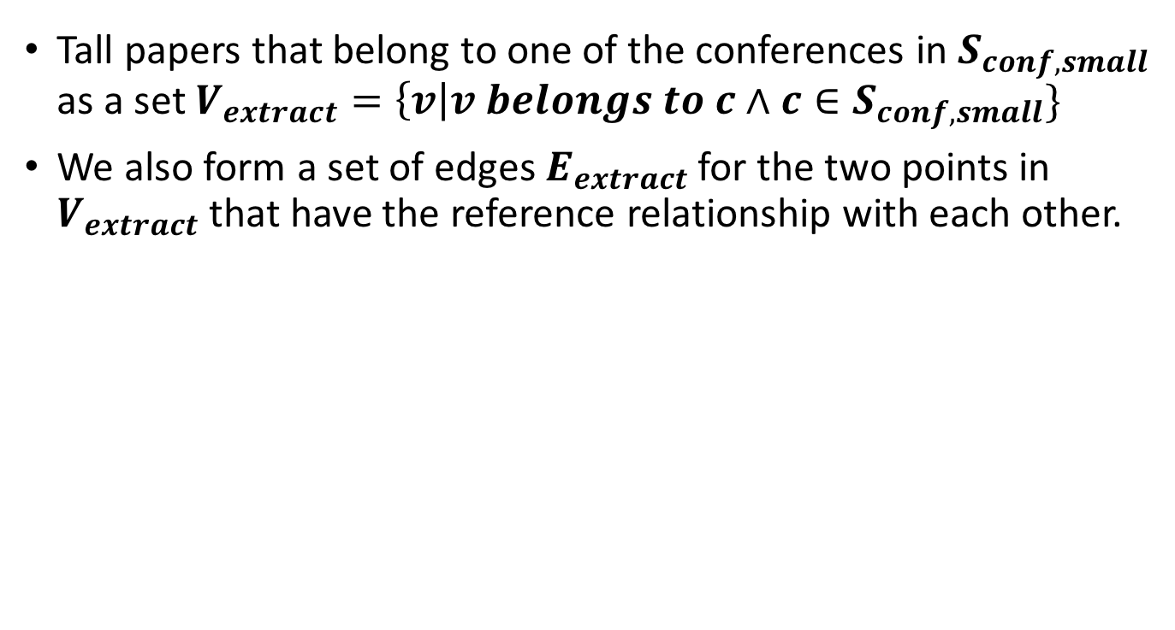
Step 4: Construct the conference-paper-keyword graph
Tall papers that belong to one of the conferences in $S_{conf, small}$ as a set $V_{extract}=\left\{v\right|v belongs to c∧c∈S_{conf,small}\}$
We also form a set of edges $E_{extract}$ for the two points in $V_{extract}$ that have the reference relationship with each other.
Notes:
Reason for using the same weight: All of them are considered as the nodes in semantic (meaning) space. 从哲学上讲，每个点都含有一定的的meaning，
We set the weight between conference and paper

Slide 12
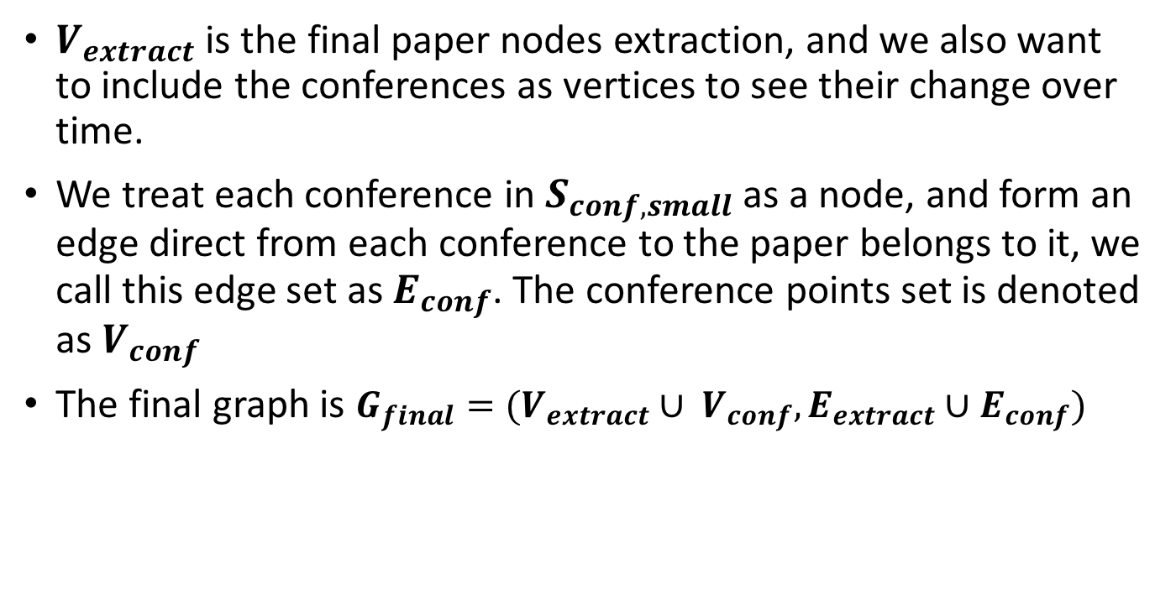
$V_{extract}$ is the final paper nodes extraction, and we also want to include the conferences as vertices to see their change over time.
We treat each conference in $S_{conf, small}$ as a node, and form an edge direct from each conference to the paper belongs to it, we call this edge set as $E_{conf}$. The conference points set is denoted as $V_{conf}$
The final graph is $G_{final}=(V_{extract}∪ V_{conf},E_{extract}∪E_{conf})$

Slide 13
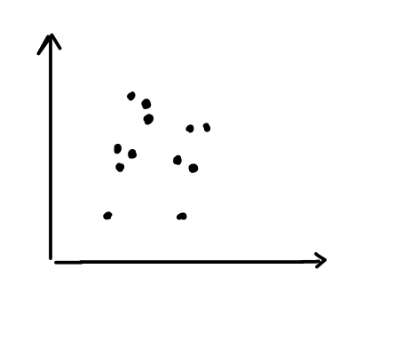
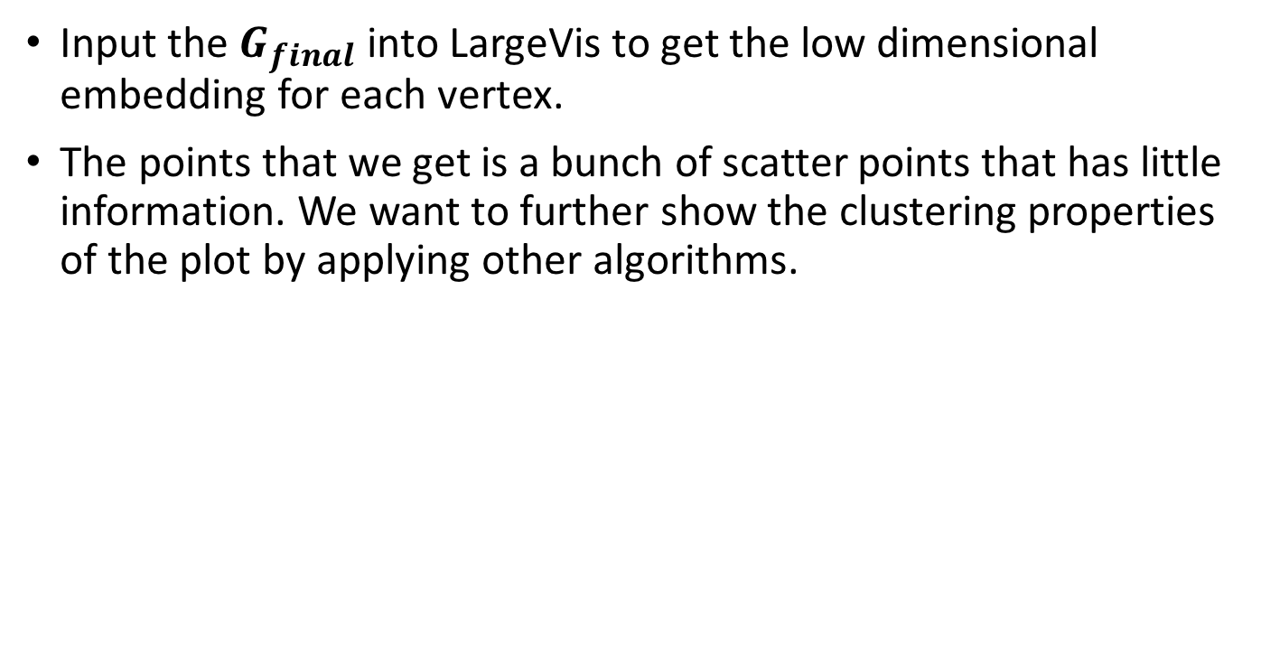
Step 5: Generate embedding
Input the $G_{final}$ into LargeVis to get the low dimensional embedding for each vertex.
The points that we get is a bunch of scatter points that has little information. We want to further show the clustering properties of the plot by applying other algorithms.

Slide 14
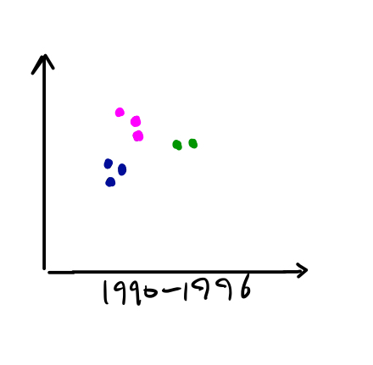
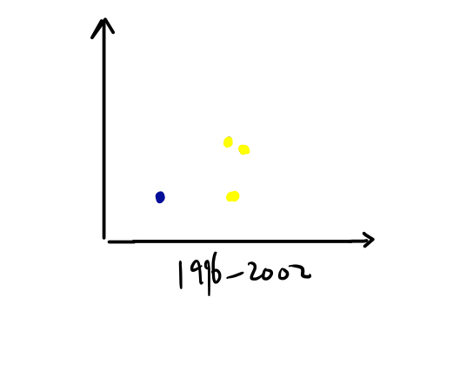
Step 6: Visualization Algorithm
Which should be noticed is that we don’t include conference points here for the algorithm processing.
The first simple step is to assign them different colors according to the conference they belong. Also, we split the points into different groups according to the time split.

Slide 15
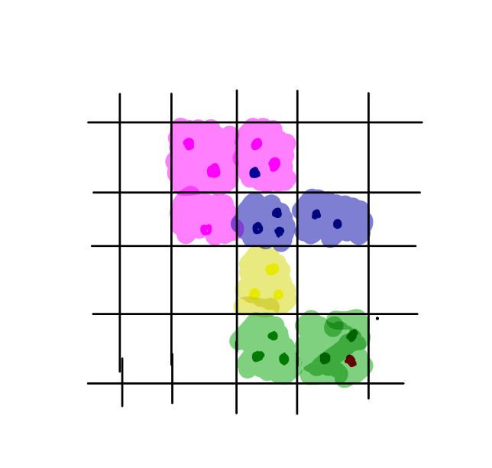
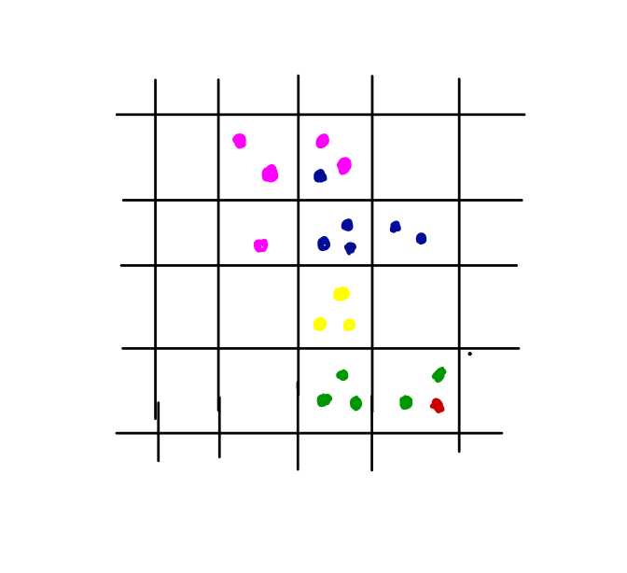
The second step is to split the points map into grids, then we calculate the most points color in each grid and assign color to each grid. If the grid has no points in it, we simply don’t give this grid a color.

Slide 16
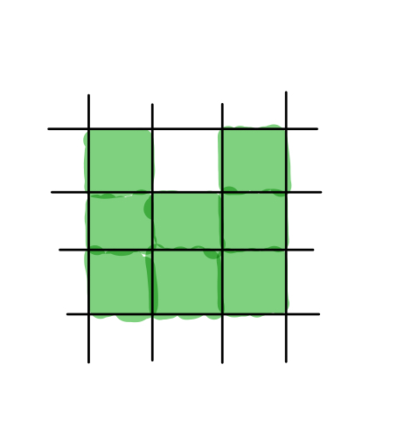
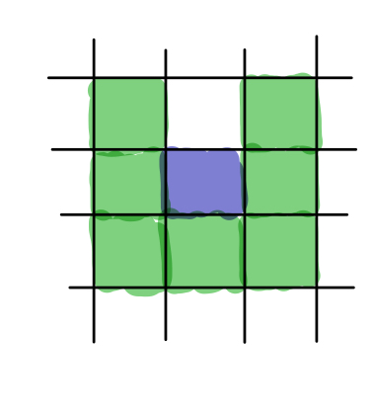
The next step is to merge a set of grids to create the ”map” or ”territory” of each color. The purpose of this step is that we find many single color grid falls in a huge amount of other color grid, which does not provide enough information.
We do this in several iteration, for each iteration:
A grid is changed to the surrounding color if it’s surrounded by a set of grids of same color larger than a threshold.
The threshold needed to change grid to white color is different.

Slide 17
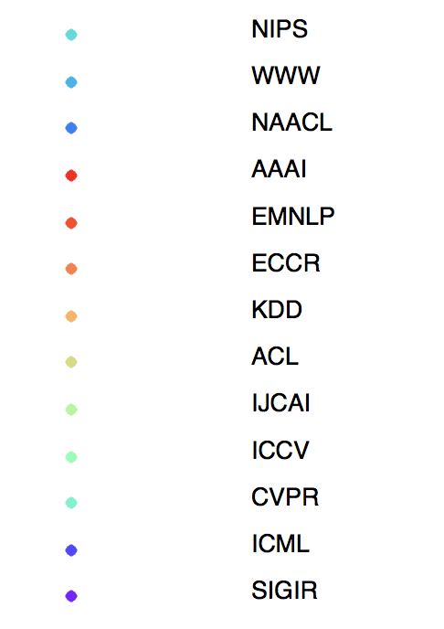
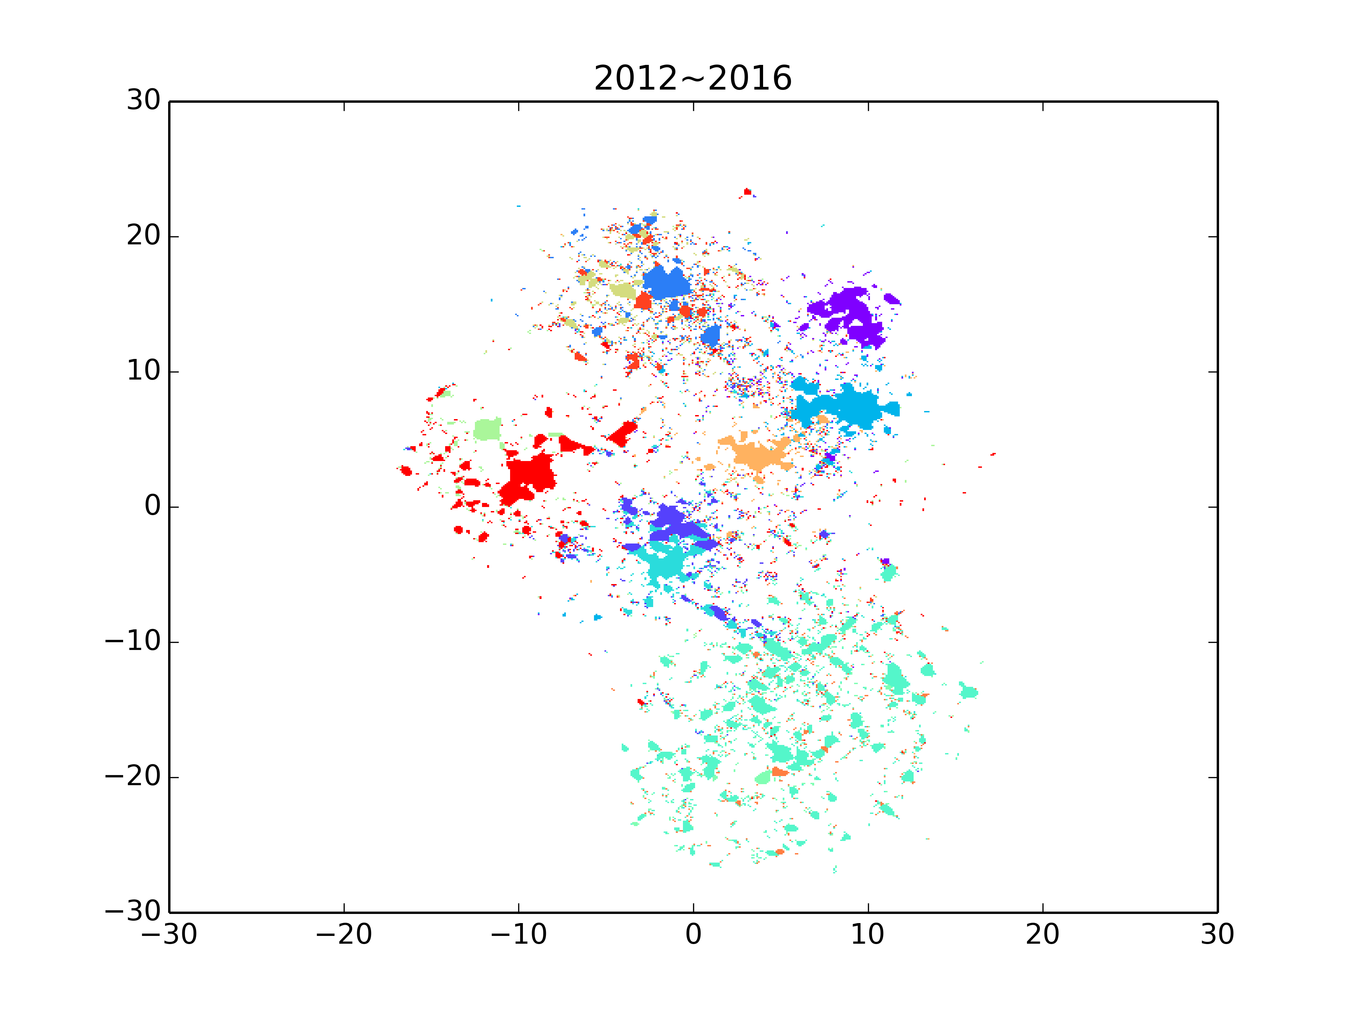
The final step is to add the conference point to see their changes through time, one of the example of the final product is shown as below:
Notes:
1969 ACL 1969 IJCAI 1978 sigir 1979 aaai
1983 cvpr 1987 NIPS 1987 iccv
1980 ICML 1994 www 1994 kdd

Slide 18
Notes:
1969 ACL 1969 IJCAI 1978 sigir 1979 aaai
1983 cvpr 1987 NIPS 1987 iccv
1980 ICML 1994 www 1994 kdd
1996 EMNLP 2000 NAACL

Slide 19
Potential Problems
Choices of hyper parameters
How to do quantitative experiment?
How to model the domain shift? (Which conferences shift most?)
Notes:
Eyes/ 比如神经网络至少有accuracy之类的objectives可以用来督促调整参数
icwsm 2015 Sam
Gaussian distribution’s conjective distribution
当有conference有coordinates的时候怎么看domain shift
what our tools can tell reader about the informations
general trends about AI
create some questions
which one is top topic in KDD

